Slide 1
ASR Project 7
Self-Supervised Pre-training with Synthetic or Unlabeled Speech

Slide 2
What are we doing…
Wav2vec2 unsupervised pre-training, but:
Using already pretrained base model: facebook/wav2vec2-base (English only)
Do additional pre-training in African language (in progress)
Compare fine-tuning performance between base and +pretrained model
Adding noises to test the robustness of our models fine-tuned on Kinyarwanda.
Why not pretrain from scratch?

Slide 3
Unsupervised pretraining - but how does it work?
Creates discrete representations from continuous audio input
Applies well-established technique that uses discrete data for unsupervised pretraining (Bert MLM, but tweaked for audio representations)
Also some clever tricks to make it all work end-to-end

Slide 4
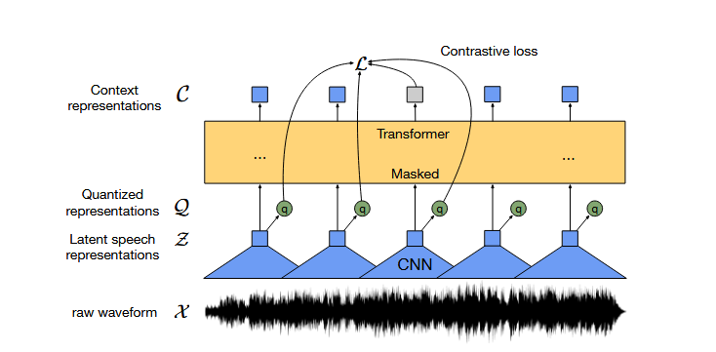
Model architecture

Slide 5
Background - discrete representations
Feature encoder: temporal convolution learns to create continuous vector representations (one per 25ms of audio, roughly every 20ms)
Since the system works end-to-end the feature encoder learns how to weigh and represent audio features for best performance
Quantization module: learns to create discrete representations from the continuous vector representations
Those discrete categories are fully trainable thanks to the use of Gumbel-Softmax

Slide 6
Quantization - a brief explanation
Needs a ‘codebook’ (set of discrete categories) of predefined size
Maps inputs from continuous scale to those categories (pick ‘closest’ category)
⇒
*Wav2vec2 actually uses two codebooks of size 320 and concatenates the representations

Slide 7
Pretraining as contrastive task
Randomly sample a proportion of the timesteps
For each mask them and subsequent M timesteps (masks may overlap). Need to do this because single timesteps are too short and to easy to predict.
Mask via a shared (between all masked steps) trained feature vector
Do not mask quantization input
Model now needs to predict the correct discrete category for the masked steps using contextual information

Slide 8
Pretraining as contrastive task
Prediction by picking from K other discrete categories (distractors, sampled from the categories of the other masked steps in the input sequence, not all categories)
Contrastive loss calculated from similarity between contextual representation (should be maximal) at masked step and true representation at masked step as well as similarities to distractor representations (should be minimal)
Loss ‘goal’ at step 2 Maximise sim(c2,q2) minimize sim(c2,q4)
c1 | c2 | c3 | c4
q1 | q2 | q3 | q4
z1 | *z2 | z3 | *z4

Slide 9
Diversity loss
Want to prevent codebook collapse (model uses only a few codebook entries, ignores the rest), instead use all categories equally often
Maximise entropy over usage distribution, i.e. model diversity loss as negative entropy
Add diversity loss to contrastive loss (weighted by some hyperparameter 𝛂)

Slide 10

Kinyarwanda
Kinyarwanda, officially known as Ikinyarwanda, is a Bantu language and the national language of Rwanda. It is spoken in Rwanda, the Democratic Republic of the Congo and Uganda (Wikipedia).
Why Kinyarwanda?
It uses Latin writing system
It is a low-resource language, yet labeled dataset for training and testing available.

Slide 11
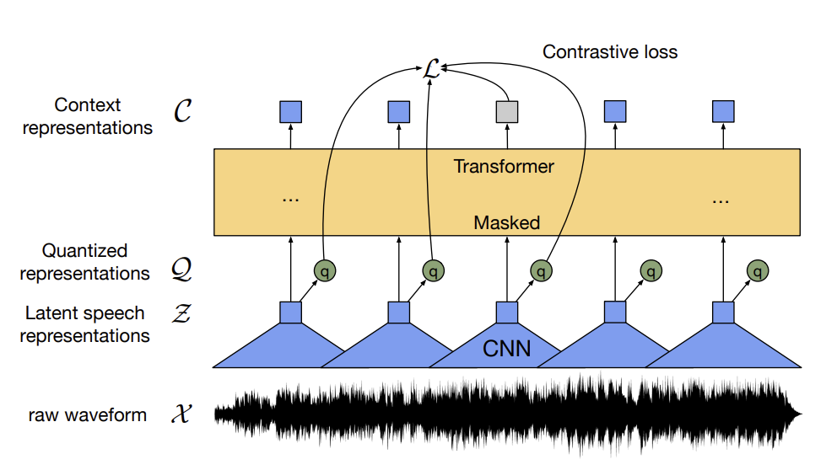
Model (wav2vec 2.0)
Wav2vac 2.0 is one of the state-of-the-art model in the field of ASR. It is a self-supervised model pre-trained on 960 hours of English audio (LibriSpeech ASR Corpus), and it can be fine-tuned on a specific ASR corpus for special use (Baevski et al., 2020).
For our experiments, we used the pre-trained facebook/wav2vec2-base model and we have fine-tuned it on Kinyarwanda by ourselves.

Slide 12
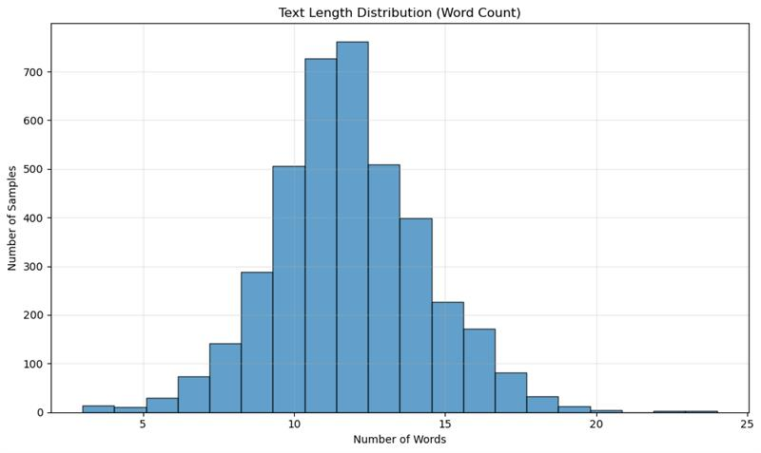
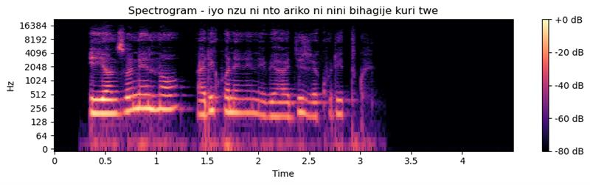
Dataset (kinyarwanda-tts-dataset)
We chose mbazaNLP/kinyarwanda-tts-dataset as our dataset for fine-tuning and testing. It consists of 3992 clips of Kinyarwanda text-to-speech corpus recorded in a studio using a voice actress.

Slide 13
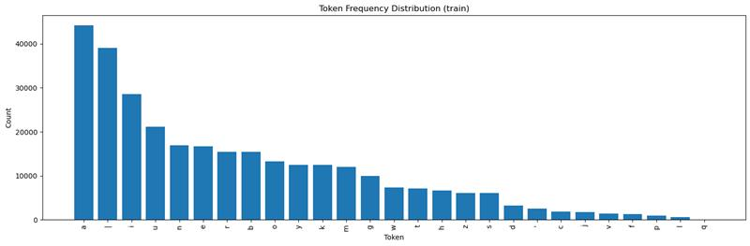
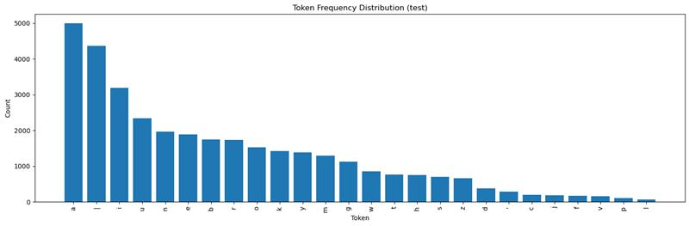
Experiment 1: Fine-tuning on Kinyarwanda
Train-test split: We shuffled the original dataset and splitted it into:
train (3600 clips of corpus)
test (392 clips of corpus)
Fine-tuning: 27000 steps in total.
Project7_kinyawannda.ipynb - Colab

Slide 14
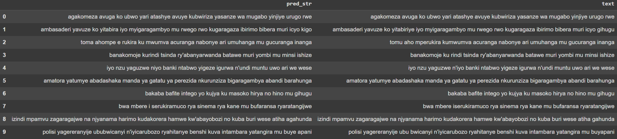
Results
WER of control model (wav2vec 2.0 without fine-tuning on Kinyarwanda): 1.01 (random guess)
WER of fine-tuned model: 0.241

Slide 15
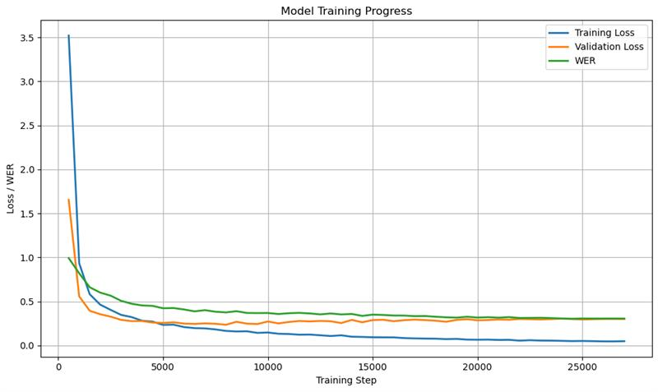

Slide 16
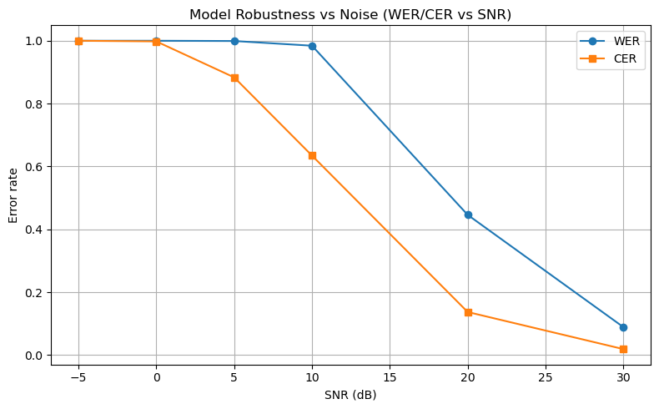
Experiment 2: Robustness test of the fine-tuned model
To test the robustness of the fine-tuned wav2vec 2.0, we added Gaussian noise to the audio.
From clean (high SNR) to very noisy (low SNR). [30, 20, 10, 5, 0, -5] decibels

Slide 17
Further Experiments
Pre-train the wav2vec 2.0 model on unlabeled Kinyarwanda audio clips from scratch
Feature extraction and analyzation
Test wav2vec 2.0 model pre-trained on Kinyarwanda with other Bantu languages (Swahili)

Slide 18
Thank you!

Slide 19
Resources
Baevski, Alexei, et al. "wav2vec 2.0: A framework for self-supervised learning of speech representations." Advances in neural information processing systems 33 (2020): 12449-12460.
Wikipedia contributors. “Kinyarwanda.” Wikipedia, 20 July 2025, en.wikipedia.org/wiki/Kinyarwanda.

